Slide 2
Remind
Text
@nths2023p
To
81010
to get notifications

Slide 3
Mission
To honor student achievement and leadership, promote educational excellence, award scholarships, and enhance career opportunities for the NTHS membership.
Mission
Commission
History
Benefits

Slide 4
NTHS is committed to:
Providing the highest quality recognition for outstanding students in career & technical education
Supplying excellent services to our diverse and multi-cultural membership & member schools
Providing scholarship opportunities for its members
Creating new & emerging relationships between the educational community & business & industry

Slide 5
NTHS is committed to:
Being a flexible organization on the leading edge of technology & constantly responding to change
Maintaining financial responsibility to meet our increasing needs
Sustaining growth, innovation & continuous improvement based upon ongoing evaluation

Slide 6
History:
Established:
in 1984 by Allen Powell and Jon Poteat
not for profit organization
recognizes outstanding students in vocational education.
improves the image of vocational education
As the image of career and technical education improved & the word “vocational” became obsolete, the name of the organization was changed in 2003 to National Technical Honor Society.

Slide 7
NTHS has seen continuous growth since its’ inception.

Slide 8
Member School Benefits
A recognized & proven program w/over 3400 member schools & colleges in the US & abroad
Contributes to a strong, positive school image & encourages service learning in the local community
Helps schools build & maintain active partnerships w/local business & industry
Encourages the involvement of parents, family & industry in the educational process

Slide 9
Member School Benefits
Encourages higher student achievement & success
Membership develops self-esteem & pride
Helps schools attract & recruit more qualified students into career & technical education programs

Slide 10
Member School Benefits
Partnered w/BPA, DECA, FCCLA, FBLA/PBL, HOSA & SkillsUSA in promoting excellence in career & technical education

Slide 11
Member Benefits
Members receive:
membership certificate
presentation folder
pin
ID card
graduation tassel
letter of recommendation customized for the member’s career portfolio
window decal
official NTHS seal to be applied to the member’s diploma or training certificate

Slide 12
Member Benefits
Personal letters of recommendation for employment, college admission & scholarships provided by the NTHS National Headquarters
Potential opportunities to be recruited by top corporations, colleges & universities
American Careers Journal
Job Board
Opportunities for discounts & special member pricing

Slide 13
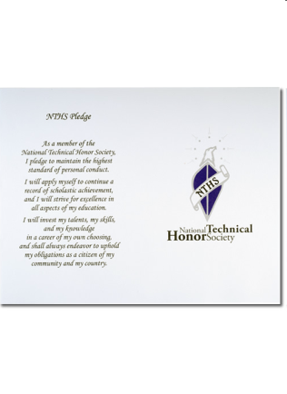
The online catalog offers graduation &
ceremonial items
(available for purchase with dues)

Slide 14
Member benefits: Scholarships:
Over 2 million dollars in scholarships have been awarded since 2005
$250,000 will be awarded in the 2022-23 school year:
Jon H. Poteat Scholarship - 250 $1000 scholarships
HOSA-NTHS scholarship - $1,000
FBLA-NTHS scholarship - $1000

Slide 15
Member Requirements
Junior or Senior
3.0 GPA:
Overall
In core department classes
Excellent school attendance
Excellent school behavior
1 time membership fee: $35
Optional items for additional purchase on application

Slide 16
Member Requirements
Applications:
Available online at phuhs.org > Clubs & Activities tab > NTHS
Attach resume to completed application
Signature from CTE course (medical or business) teacher required
1st Quarter + expected/estimated 2nd Quarter & Semester grades required
Semester attendance required
Due: Friday, November 4th
Email submission to CTE teacher

Slide 17
Future Dates
Acceptance Letters:
TBD
Dues & Grad Swag Purchase Deadline:
TBD
Induction Ceremony:
TBD

Slide 18
Questions? WWW.NTHS.ORG

